Slide 1
ROCO218: Control Engineering Dr Ian Howard Lecture 4 Transfer Functions

Slide 2
Transfer functions
A differential equation is an equation which contains derivative terms
Differential equation can often be used to describe a dynamical system in the time domain
For example, a differential equation can capture the relationship between the force input f(t) and output position x(t) of a mass-spring damper
f(t)
differential
equation
y(t)
A transfer function is an expression that describes a system the s-domain that relates the output to the input
To get to the s-domain we use the Laplace transform
F(s)
transfer
function
Y(s)

Slide 3
Transfer functions
Consider a system in the s-domain with input X(s) and output Y(s)
X(s)
H(s)
Y(s)
Given the s-domain input X(s) and output Y(s) the transfer function H(s) is given by the ratio of the output Y(s) to the input X(s)
H(s) = Y(s) / X(s)
The output of the system can Y(s) therefore be found by multiplying the input X(s) with the transfer function H(s)
Y(s) = X(s)H(s)
For example, if the input signal is a step then
X(s) = 1/s
Therefore in this case
Y(s) = H(s)/s

Slide 4
Transfer functions in series
We can use block diagrams to pictorially expresses flows and relationships between elements in system represented by their transfer functions
Such signal flow graphs can often be simplify using simple rules
Consider two blocks in series
Z(s)
X(s)
H1(s)
H2(s)
Y(s)
Looking at midpoint we see that
Z(s) = X(s)H1(s)
Therefore
Y(s) = Z(s)H2(s)
Y(s) = X(s)H1(s)H2(s)
So we can represent H1(s) and H2(s) in series by a single block with a transfer function equal to their product H1(s)H2(2)
X(s)
H1(s)H2(s)
Y(s)
This result generalized to multiple blocks in series

Slide 5
Transfer functions in parallel
Consider two blocks in parallel
H1(s)
X(s)
+
Y(s)
H2(s)
The output from the summer is
Y(s) = X(s)H1(s)+ X(s)H2(s
Therefore
Y(s) = X(s)(H1(s)+H2(s))
So we can represent H1(s) and H2(s) in series by a single block with a transfer function equal to their sum H1(s) + H2(2)
X(s)
H1(s)+H2(s)
Y(s)
This result generalized to multiple blocks in parallel and also to subtraction rather than addition

Slide 6
Closed loop system
Forward path
E(s)G(s)
+
E(s)
Input
X(s)
+
G(s)
Y(s)
Output
-
Y(s)H(s)
H(s)
Feedback path
Substituting in error term E(s)
Collecting factors of Y(s) terms
Calculating the transfer function
This is a very important result
for feedback control!

Slide 7
Typical block diagram for simple feedback controller
reference input, R(s)
plant inputs, U(s)
error, E(s)
output, Y(s)
X(s)
+
pre-filter
G₁(s)
-
control
G_{c}(s)
plant
G_{p}(s)
post-filter
G₂(s)
Y_{Pf}(s)
feedback
H(s)
feedback, H(s)Y(s)
Let us compute the overall transfer function of this system
To do so we first simplify the structure

Slide 8
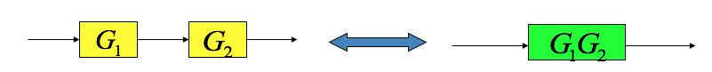
Typical block diagram for simple feedback controller
X(s)
+
pre-filter
G₁(s)
-
control
G_{c}(s)
plant
G_{p}(s)
post-filter
G₂(s)
Y_{Pf}(s)
feedback
H(s)
Let us compute the overall transfer function of this system
To do so we first simplify the structure
Lets consider the control and the plant
Can be combined into a single block

Slide 9
Typical block diagram for simple feedback controller
X(s)
+
pre-filter
G₁(s)
-
Control and plant
G_{c}(s)G_{p}(s)
post-filter
G₂(s)
Y_{Pf}(s)
feedback
H(s)
Let us compute the overall transfer function of this system
To do so we first simplify the structure
Lets consider the control and the plant
Can be combined into a single block

Slide 10
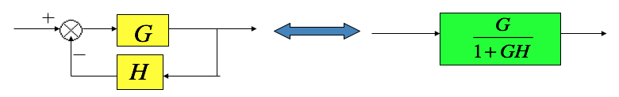
Typical block diagram for simple feedback controller
X(s)
+
pre-filter
G₁(s)
-
Control and plant
G_{c}(s)G_{p}(s)
post-filter
G₂(s)
Y_{Pf}(s)
feedback
H(s)
Now consider the feedback loop
Can be combined into a single block

Slide 11
Typical block diagram for simple feedback controller
G_{c}(s)G_{p}(s)
_______________
[1+G_{c}(s)G_{p}(s)H(s) ]
X(s)
pre-filter
G₁(s)
post-filter
G₂(s)
Y_{Pf}(s)
Now consider the feedback loop
Can be combined into a single block

Slide 12
Typical block diagram for simple feedback controller
G_{c}(s)G_{p}(s)
_______________
[1+G_{c}(s)G_{p}(s)H(s) ]
X(s)
pre-filter
G₁(s)
post-filter
G₂(s)
Y_{Pf}(s)
Now consider the three blocks in series
These can be combined into a single block

Slide 13
Typical block diagram for simple feedback controller
G₁(s)G_{c}(s)G_{p}(s)G₂(s)
_______________
[1+G_{c}(s)G_{p}(s)H(s) ]
X(s)
Y_{Pf}(s)
Now consider the three blocks in series
These can be combined into a single block

Slide 14
Block diagram reduction summary
Combining blocks in cascade or in parallel
2. Moving a summing point from behind a block

Slide 15
Block diagram reduction summary
3. Moving a summing point ahead of a block
4. Moving a pickoff point from behind a block
5. Moving a pickoff point from ahead of a block

Slide 16
Block diagram reduction summary
6. Eliminating a feedback loop
7. Swap order of two neighboring summing points

Slide 17
ROCO218: Control Engineering Dr Ian Howard Lecture 4 Transfer function RLC example

Slide 18
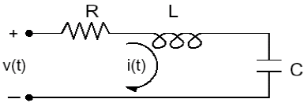
Series RLC circuit
Adding up the contributions to overall applied voltage

Slide 19
Series RLC circuit in the s-domain
From differential equation of voltage
Taking Laplace transforms
Similarly for capacitor voltage

Slide 20
Series RLC circuit in the s-domain
Transfer function is given by
Cancelling current term

Slide 21
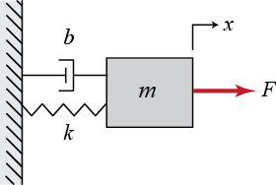
Analysis of a simple mechanical system
Consider the mass-spring-damper system shown below:
Use these parameters
M = 0.5 kg
b = 5 N s/m
k = 10 N/m
F = 1 N
Describe using differential equation of motion
Balancing the forces gives:

Slide 22
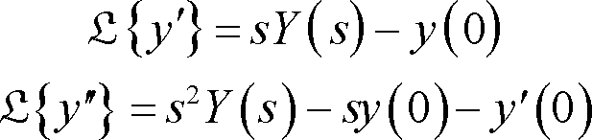
Analysis of a simple mechanical system
So given
Remember in the general case the Laplace transform of differentials include initial conditions
The Laplace transform gives

Slide 23
Analysis of a simple mechanical system
So given
Setting initial conditions to zero
Use these parameters
M = 0.5 kg
b = 5 N s/m
k = 10 N/m
F = 1 N

Slide 24
ROCO218: Control Engineering Dr Ian Howard Lecture 4 Modelling a DC motor with transfer function

Slide 25
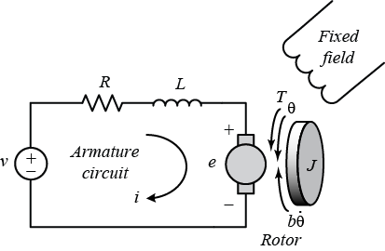
Revision: DC motor dynamics
Motor torque T_{m} is given by the current multiplied by the torque constant of the motor
Mechanical resisting torque T_{r} is given by inertia and viscous friction
Therefore equating the two terms gives torque equation

Slide 26
Revision: DC motor dynamics
Summing voltages around the circuit gives voltage equation

Slide 27
Motor solution using Laplace transformations
Taking Laplace transforms of the differential equations that describe the motor mechanical dynamics:
Becomes

Slide 28
Motor solution using Laplace transformations
Taking Laplace transforms of the differential equations that describe the motor voltages:
Becomes

Slide 29
Motor solution using Laplace transformations
Substituting
Into
and thereby laminating current I(s)

Slide 30
Motor solution using Laplace transformations
So from
setting K_{t} = K_{e}= K gives
factoring out 1/K

Slide 31
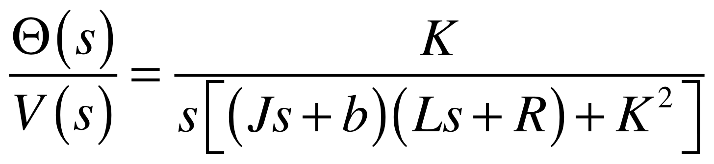
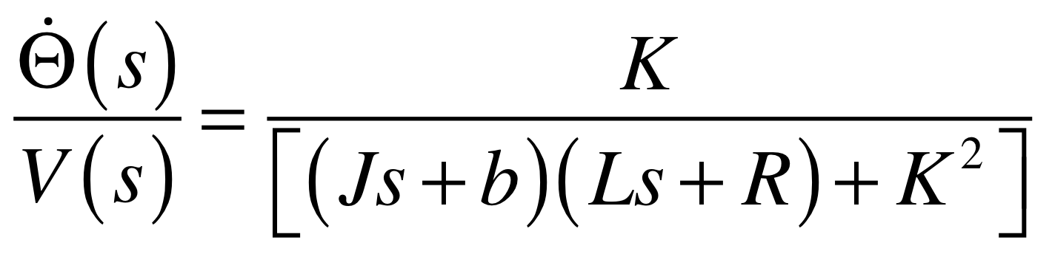
Motor transfer function
Result of a transfer response output position for a DC electric motor given its input voltage
Can differentiate this expression to get the transfer function for speed by multiplying by the transfer function of a differentiator (=s)

Slide 32
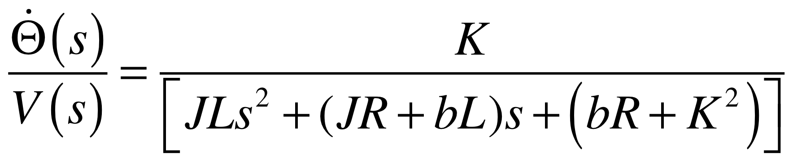
Simulink model simulation transfer function
Expand the expressing into powers of s so can be directly used with Matlab tf function.
Becomes

Slide 33
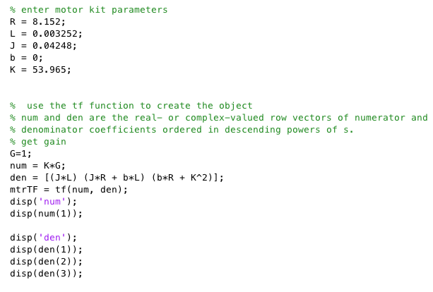
Use Matlab to calculate Simulink parameters
Use real motor parameter values:
R = 8.152 Ω
L = 3.252 mH
J = 0.04248 kg.m2
b = 0
K_{t} = 53.965 N.m/A
K_{e} = 53.965 V/rad/sec

Slide 34
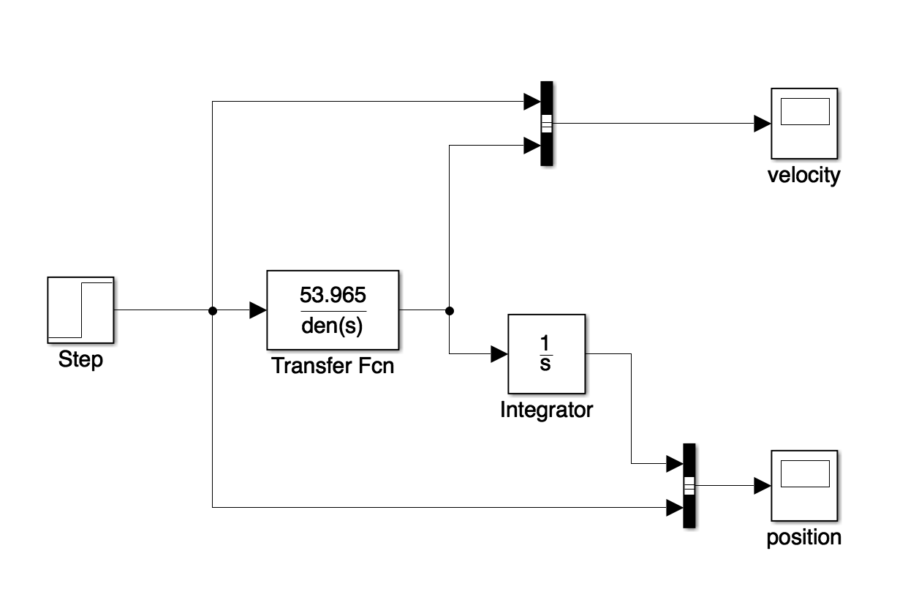
Building the Simulink model simulation
Use multiplexers to joint step and output signals
Excite circuit with a step function
Display outputs using scopes

Slide 35
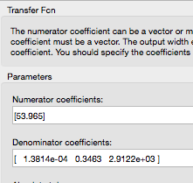
Enter transfer function parameters
Use real motor parameter values in transfer function
Better to use Matlab to compute values in workspace and refer to them here is Simulink
Makes it easy to change values without having to update numerical values

Slide 36
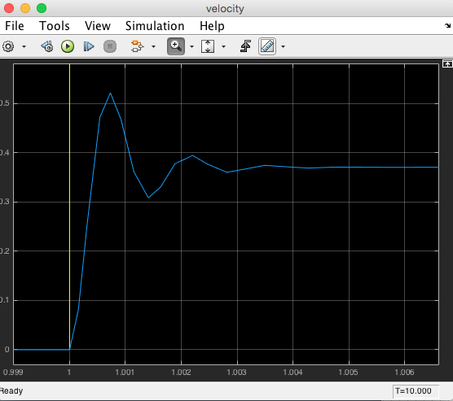
Examine angular speed plot
The speed plot when zoomed in will look like this.
Angular velocity settles time is about 4ms

Slide 37
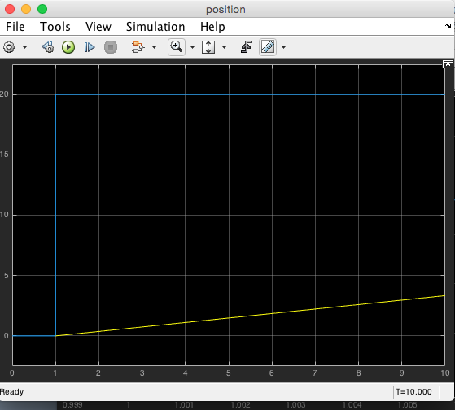
Examine angular position plot
Shows linear increase in angular position when step function activated

Slide 38
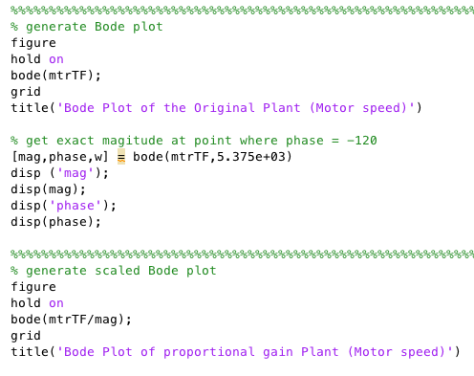
Bode plots of the transfer function
It is easy to generate a Bode plot of transfer functions.
We can use the Matlab bode function
This plots the amplitude and phase response of the transfer function

Slide 39
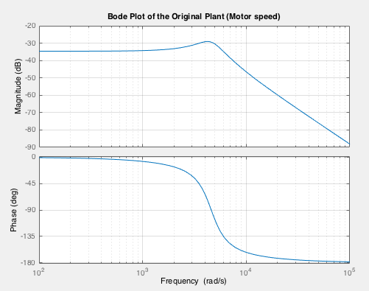
Bode plots of the transfer function

Slide 40
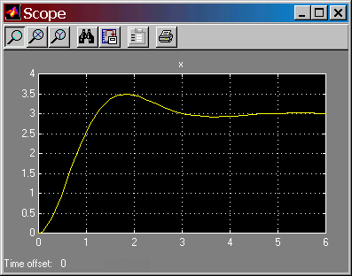
Output results
Underdamped response.
Overshoot of 0.5.
Final value of 3.
Is this expected?

Slide 41
Interlude 10 minute break

Slide 42
ROCO218: Control Engineering Dr Ian Howard Lecture 4 Poles and zeros

Slide 43
Poles of a transfer function
The poles of a transfer function are the values of s that make the function evaluate to infinity.
The value of s can be visualized on the s-plane
The poles are therefore the roots of the denominator polynomial
For example: the expression
Has a pole at s = -1
And a pole at s = -3
Complex poles always appear in complex-conjugate pairs
The transient response of system is determined by the location of poles

Slide 44
Zeros of a transfer function
The zeros of a transfer function are the values of s that make the transfer function evaluate to zero.
They are therefore the zeros of the numerator polynomial
For example: The expression
has a zero at s = -2
Complex zeros always appear in complex-conjugate pairs

Slide 45
Plotting poles on the complex plane
Complex number component axis
x
x
x
x
Real number
component axis
x
x

Slide 46
Exponential decay
x
Effect of a -ve real pole
System exhibits exponential decay
The signal will eventually decay to a constant value of zero
Therefore the system is stable

Slide 47
Damped sinusoid
x
x
Effect of a -ve real part complex pole
System exhibits exponential damped sinusoidal decay
The signal will eventually decay to a constant value of zero
Therefore the system is stable

Slide 48
Exponentially growing sinusoid (unstable)
x
x
Effect of a +ve real part complex pole
System exhibits exponentially sinusoidal growth
The signal will eventually go to infinity (in a mathematical model)
Therefore the system is unstable

Slide 49
Stable behavior
A system is stable if bounded inputs produce bounded outputs
The complex s-plane is divided into two regions:
Stable region, which is on the left half of the plane
Unstable region, which is on the right half of the s-plane
s-plane
x
x
jω
x
x
σ
x
stable
x
unstable

Slide 50
Unstable behavior
If the output of a process grows without bound for a bounded input, the process is referred to a unstable
If the real portion of any pole of a transfer function is positive, the process corresponding to the transfer function is unstable
If any pole is located in the right half plane, the process is unstable.
s-plane
jω
x
x
x
x
σ
x
x
stable
unstable

Slide 51
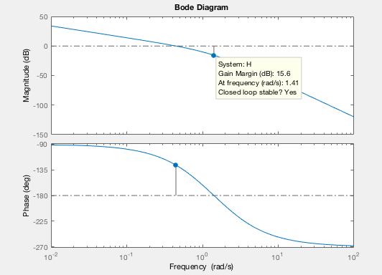
Stable feedback system
Consider the open loop transfer function
When K=1 this has the corresponding Bode plot
We see the gain margin is 15.6dB
This corresponds to a linear gain of 6.0256
Unity feedback losed loop transfer function is given by

Slide 52
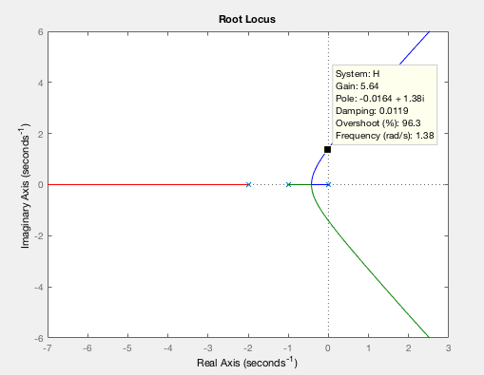
Stable feedback system
Factor K thus affects pole location
Thus we can change the location of the close loop poles by changing the gain K
If we plot the locations of the poles and zeros on the s-plane as gain K changes, we get what is known as the ”root locus” plot
From the plot we can see when they poles moves to the unstable RHS of of s-plane

Slide 53
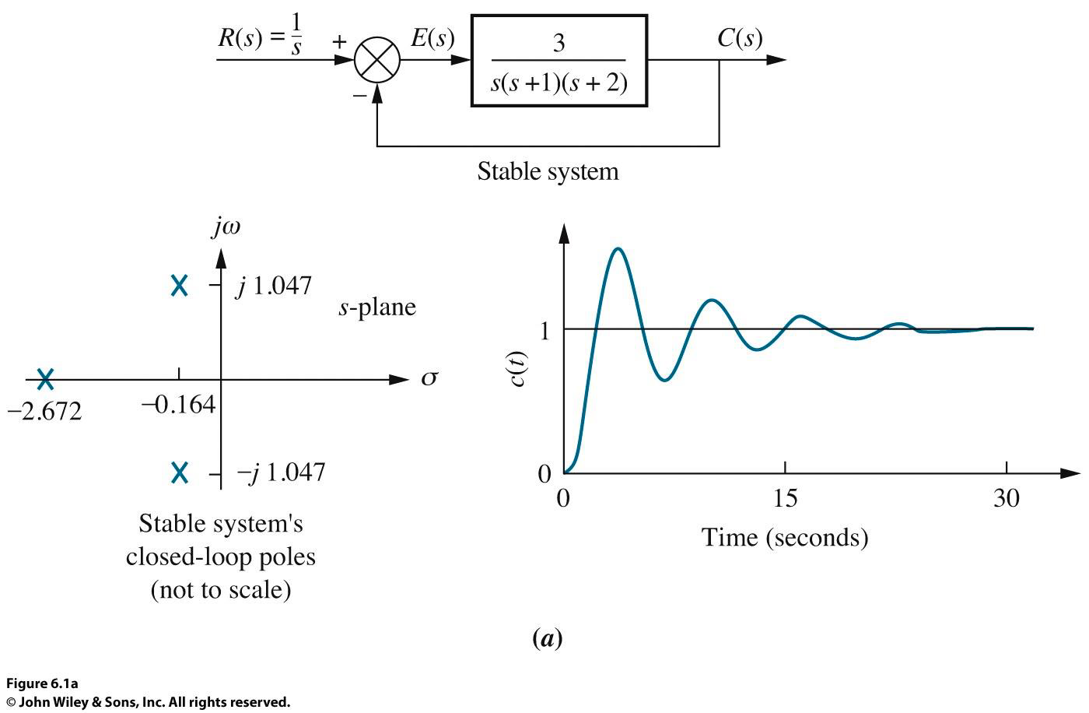
Stable feedback system
Below we use a low gain of 3 and the system is stable

Slide 54
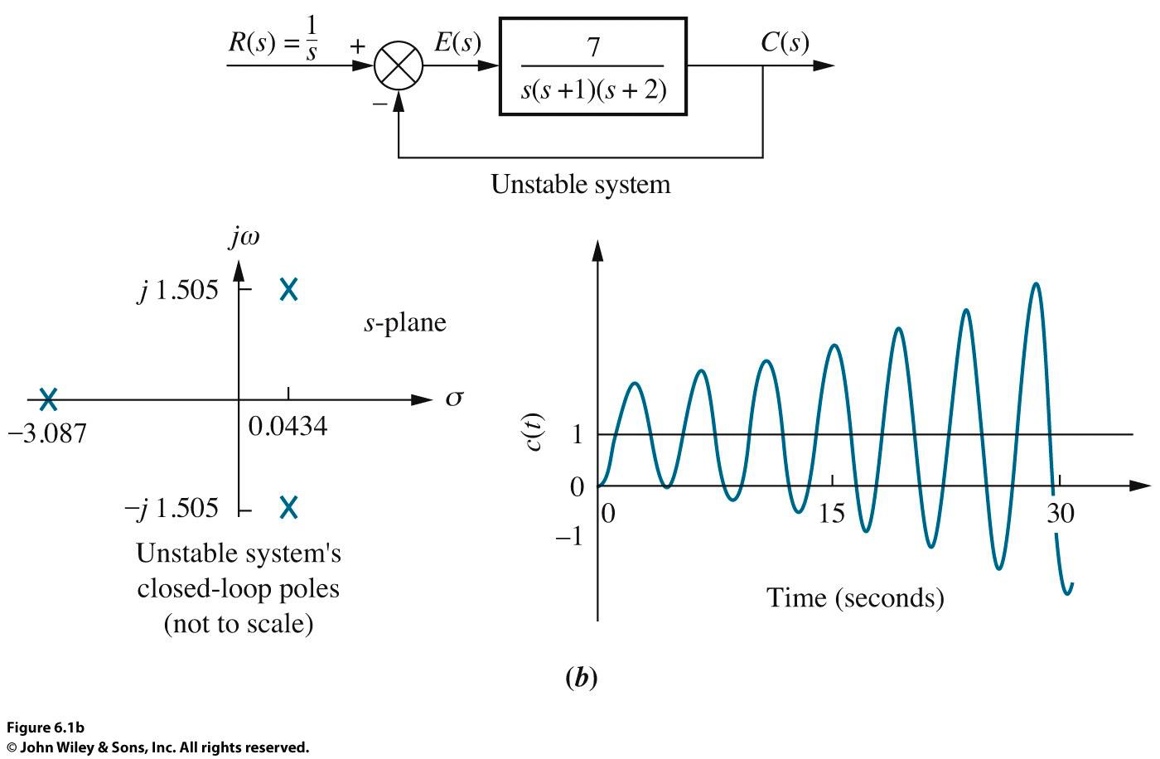
Unstable feedback system
However as the gain goes above the gain margin of the system will go unstable
Below we use a higher gain of 7 and the system is stable

Slide 55
ROCO218: Control Engineering Dr Ian Howard Lecture 9 PID control

Slide 56
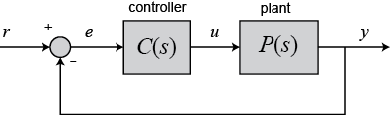
Simple feedback controller
Plant characteristics are often fixed
We need to design a controller to achieve required plant performance
Have to be careful because feedback system can go unstable!
So what should the controller be?

Slide 57
Adding a PID controller
Place a PID controller C(s) in series with the plant P(s) and make use of negative feedback
A well-designed control system will ensure
We reach a target value quickly
Without overshoot
With low steady state error.

Slide 58
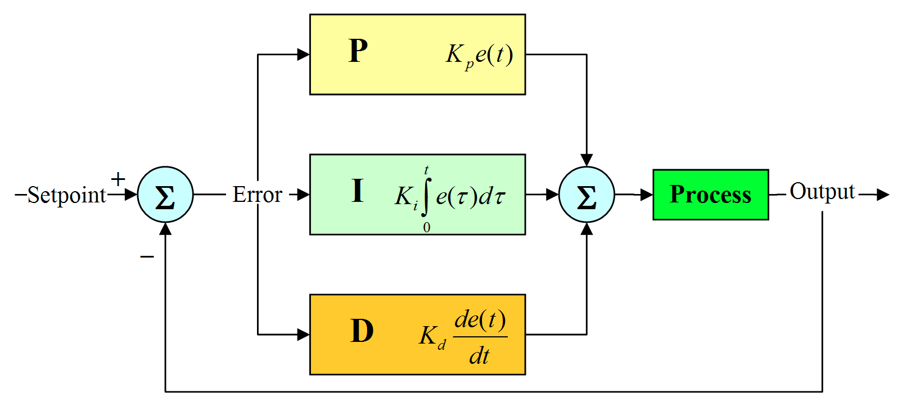
PID parallel pathways
PID is a mathematical algorithm that the controller uses to compensate for load fluctuations and changes in set point.
These operations are executed on the error between the set point and the actual value.
They determine how the plant will react to change
A PID controller consists of 3 parallel elements that are located in the forward path in a feedback controller scheme located before the plant
The plant to be controller received the sum of these three processed signals as its input
The 3 PID elements have different effects

Slide 59
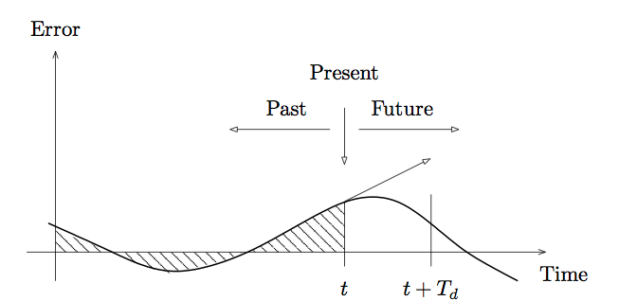
Proportional term
The proportional term directly relates to the error value at the present moment in time
The proportional gain is given as K_{p}
Proportional gain can improve rise time
If K_{p} too high the system can become unstable

Slide 60
Integral term
The integral term relates to a past values of the error up to the present point in time
It is proportional to both the magnitude of the past error and its duration
The integrator gain is given as K_{i}
Integral term eliminates residual steady-state error

Slide 61
Derivative term
The derivative term that is proportional to the slope of the error over time and relates to a prediction of what the error will be like in the future
The differentiator gain is given as K_{d}
Derivative term improves settling time and stability of the system

Slide 62
PID differential equation
u(t)
e(t)
Relationship between input error e(t) and output control signal u(t) is thus captured by the differential equation:

Slide 63
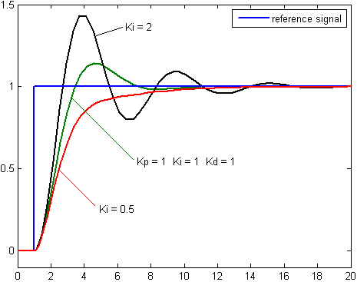
Changing PID controller characteristics
Tuning PID parameters strongly affects controller performance

Slide 64
Transfer function of PID controller
Differential equation that described PID controller
Taking Laplace transformations and rearranging gives the transfer function for the PID controller:

Slide 65
ROCO218: Control Engineering Dr Ian Howard Lecture 9 Simple PID control example

Slide 66
Analyze a simple mechanical system
Consider the mass-spring-damper system shown below:
Describe using differential equation of motion
Balancing the forces gives:

Slide 67
Analyze a simple mechanical system
Given the differential equation of motion
The Laplace transform gives
Use these parameters
M = 0.5 kg
b = 5 N s/m
k = 10 N/m
F = 1 N

Slide 68
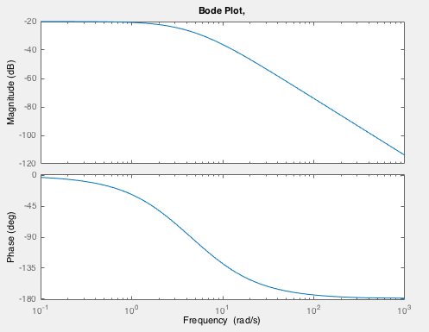
Bode plot of a transfer function
Lets use Matlab to generate a Bode plot of the transfer function of the mechanical system
You should get a plot that looks like this:
Find the -3dB point
Where response goes down -3dB from max
Estimate rise time
Time needed for value to go from 10% to 90%

Slide 69
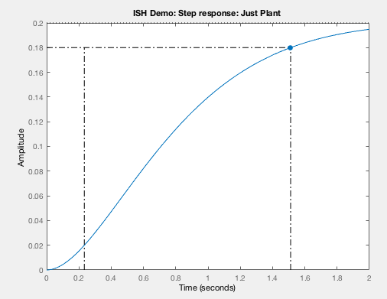
Generate step response
Lets use the Matlab step function to plot the step response of the system.
Look at the Matlab help for the function step
Pass it a time vector that gives time values between 0 and 2 seconds in steps of 0.01 seconds.
What is the rise time here?

Slide 70
Adding a PID controller
Lets now place a PID controller C(s) in series with the plant P(s) and make use of negative feedback
A well-designed control system will ensure
We reach a target value quickly
Without overshoot
With low steady state error.

Slide 71
PID differential equation
Relationship between input error e(t) and output control signal u(t) captured by the differential equation:

Slide 72
Example: Overall open-loop transfer function
Controller gives
Plant gives
Product of these series elements gives

Slide 73
Overall closed-loop transfer function
Given this feedback arrangement and
serial controller and plant configuration
The close loop transfer function is

Slide 74
Example: Overall closed-loop transfer function
So given
The close loop transfer function is

Slide 75
ROCO218: Control Engineering Dr Ian Howard Lecture 9 Simulating PID in Matlab

Slide 76
Building plant transfer function in Matlab
Matlab can perform symbolic manipulation
(similar to Mathematica)
The tf function generates Matlab format transfer functions
You can use it to specify a complex transfer function
Or even a simple simple ones
Then use mathematical manipulation on the variable to generate other transfer function relationships
You can of course always do the maths by hand if you like
But Matlab is less likely to make a mistake than a human!
You can then use Matlab functions like Bode and Nyquist to directly analyze the transfer functions

Slide 77
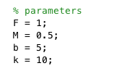
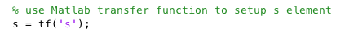
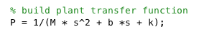
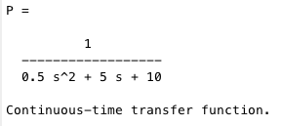
Building plant transfer function in Matlab
Define plant parameter variables
Build the plant transfer function
Displaying content of P gives

Slide 78
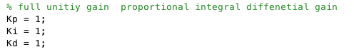
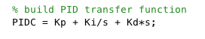
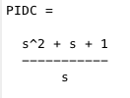
Building plant transfer function in Matlab
Define example PID parameter variables
Build the PID controller transfer function
Displaying content of PIDC gives

Slide 79
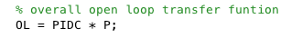
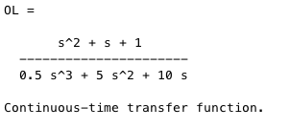
Calculating open-loop transfer function
Given plant and PID transfer functions
Open-loop transfer function is their product
Displaying content of OL gives

Slide 80
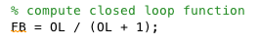
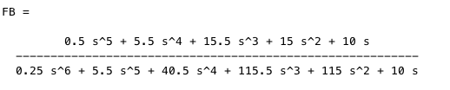
Calculating closed-loop transfer function
Given plant and PID transfer functions
Open-loop transfer function is their product
Closed-loop transfer function is given by
Displaying content of FB gives

Slide 81
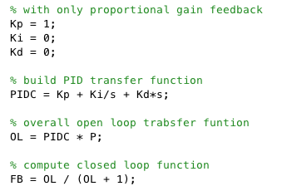
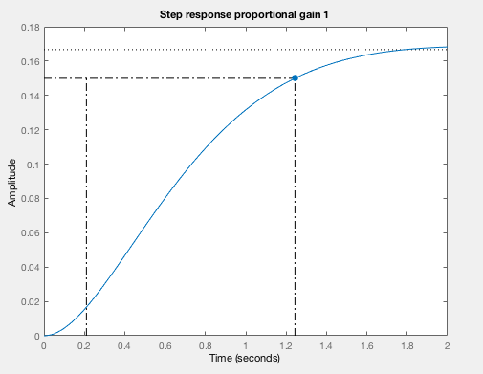
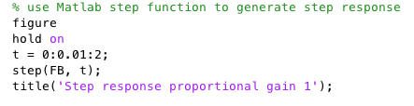
Feedback control with only proportional gain
K_{p} = 1
Not much has changed
from open loop response!

Slide 82
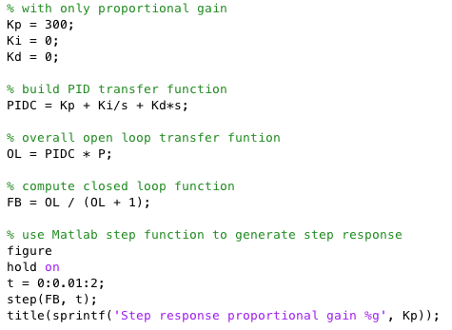
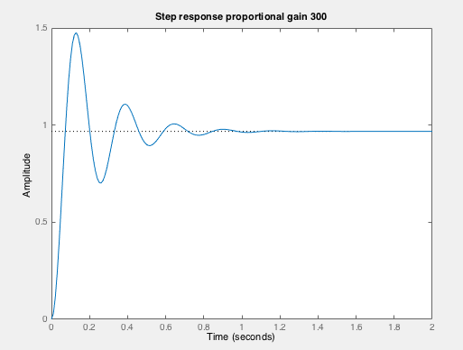
Feedback control with only proportional gain
K_{p} = 300
Quite different from open loop response!
Reaches unity
Faster rise time
But oscillations

Slide 83
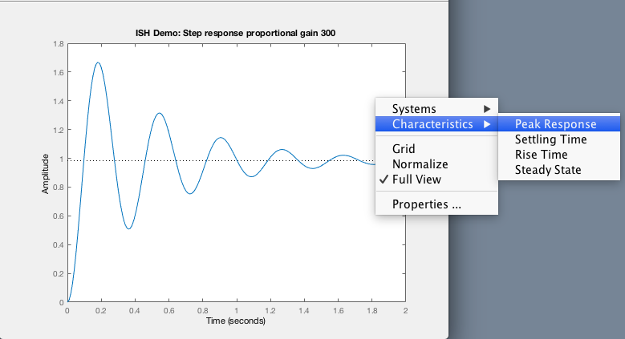
Use Matlab step function to show response characteristics
K_{p} = 300

Slide 84
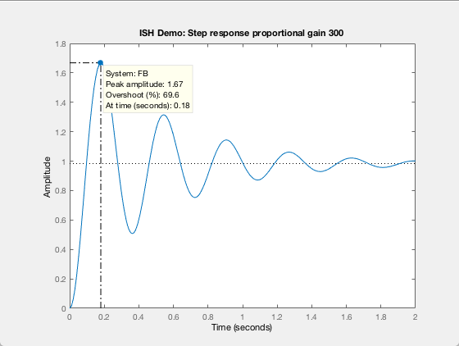
Feedback control with only proportional gain
K_{p} = 300
Peak response

Slide 85
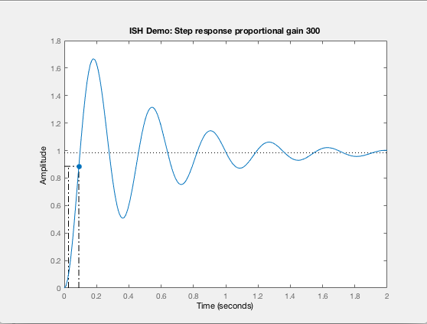
Feedback control with only proportional gain
K_{p} = 300
Rise time

Slide 86
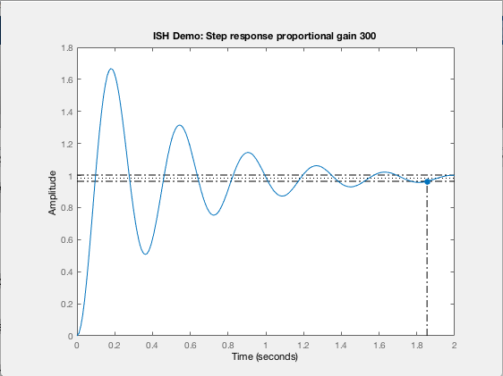
Feedback control with only proportional gain
K_{p} = 300
Settle time

Slide 87
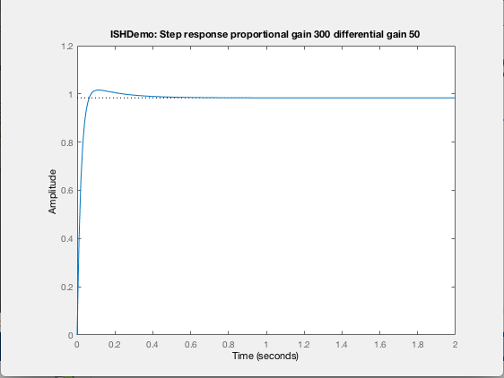
With proportional & differential gain
K_{p} = 300 and K_{d} = 50
Fast rise time
No oscillations
Overshoot
But quite good!
Exact response of course depends on values

Slide 88
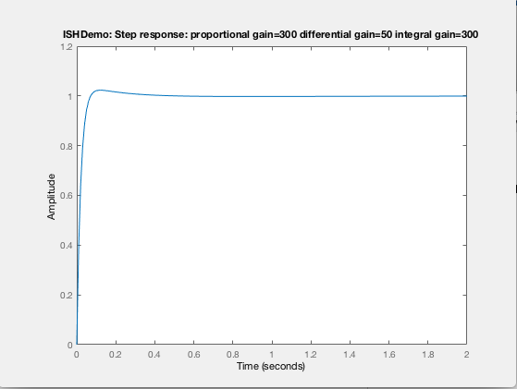
With full PID gains
K_{p} = 300, K_{d} = 50, K_{i} = 300
Low steady-state error

Slide 89
Compare
Just P
Open loop
PD
But precise response depends on appropriate tuning of all feedback components
PID

